Slide 1

Posture Detection
Vedant Singh (1702910186)
Shivansh Srivastava (1702910153)
Jagrat Katara(1702910077)
Ojasva Verma(1702910100)
Mentor
Prof. Gaurav Parashar

Slide 2

Introduction
The current times when the whole world has shifted rapidly towards technology, eventually leading to a huge workforce of employees working on laptops or desktops. This has reduced the amount of physical work pressure but at the same time has also increased the strain on certain body parts like the spine and the eyes.
Monitoring their posture and notifying them, in situations where the employees are in a risk of any of such harmful disease, can help lower it and thereby increase their productivity. Some unique features of this project make it more suitable due to its memory and time efficiency, and user-friendly interface.

Slide 3

To help organizations in becoming more conscious about employee health. Creating a posture monitoring system which can ease the task of continuously monitoring employee’s sitting posture through Computer Vision through which we can identify and analyze wrong posture. To increase the efficiency of this process by using a system which captures snapshots at regular intervals rather than continuously recording videos. This would reduce the memory usage and make the solution lightweight.
OBJECTIVE

Slide 4
Postures
Incorrect
Hunchback
Slouch
Leaning
Straight
Slight recline
Slight bend
Correct

Slide 5

Technologies
Python3
OpenCV
OpenPose

Slide 6
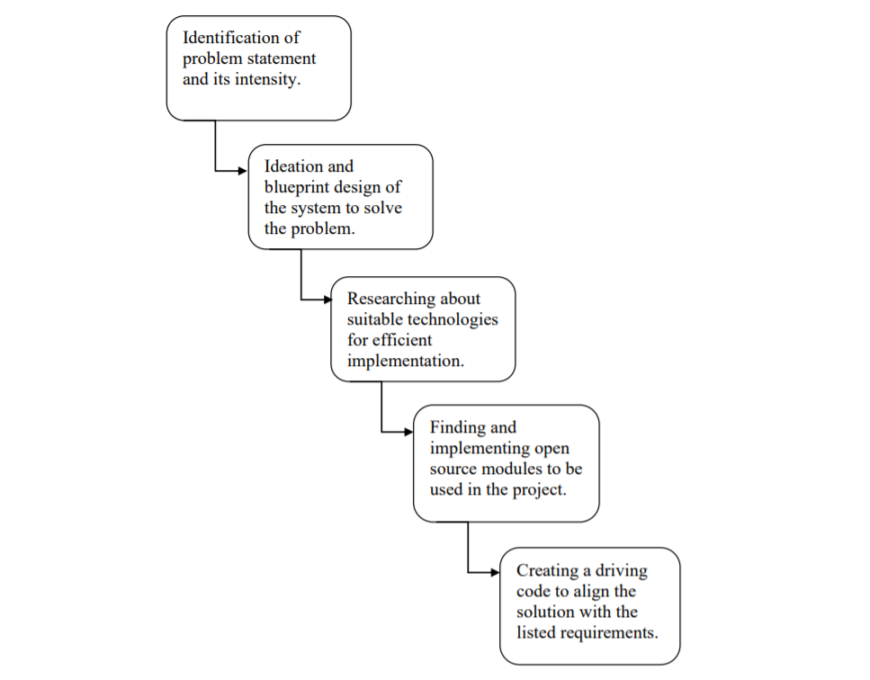
Methodology

Slide 7
Implementation
Steps involved :
Implementing the OpenPose Module to convert human figure into stick diagrams.
Creating an analysis module for calculating angles between various points of the stick diagram like Neck joint, Hip joints, Knees etc.
Extending the module to capture images at regular intervals by using cv2.VideoCapture(0) function offered by OpenCV.
Changing the static module to be driven by a piece of code that makes it capture snapshots at regular intervals.
Finally analyzing the time interval of continuous wrong posture and notifying the same.

Slide 8
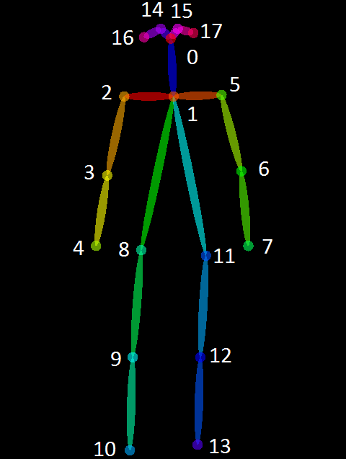
Identifying key points through stick diagram
Using OpenPose model invented by CMU Perpetual Computing Lab.

Slide 9
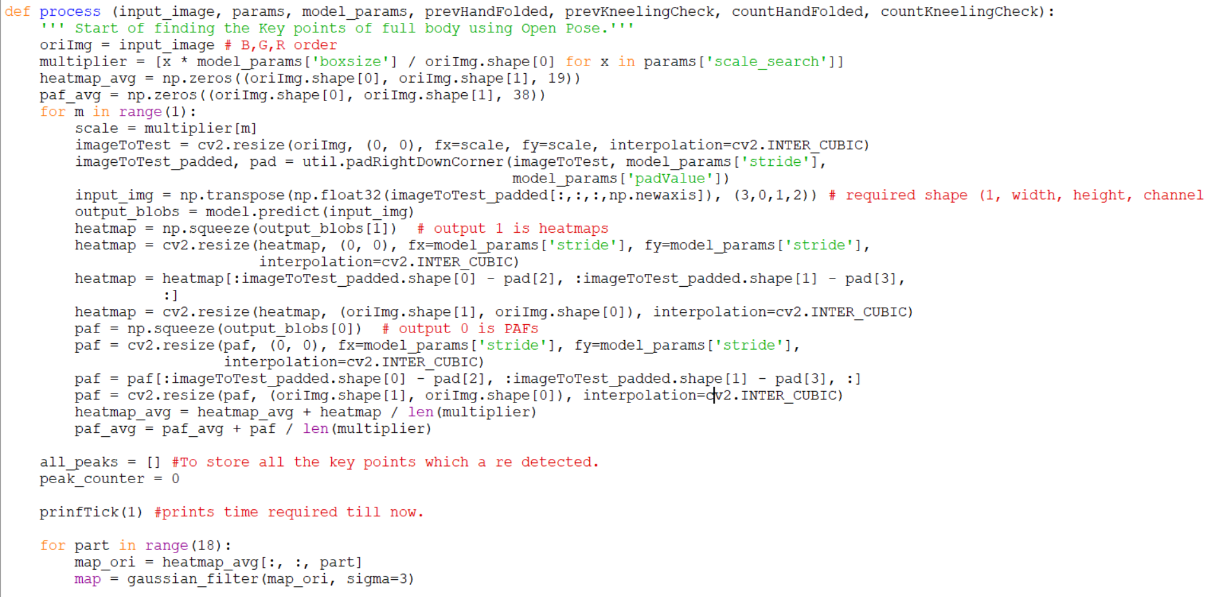
Base Module Functionalities – 1.1

Slide 10
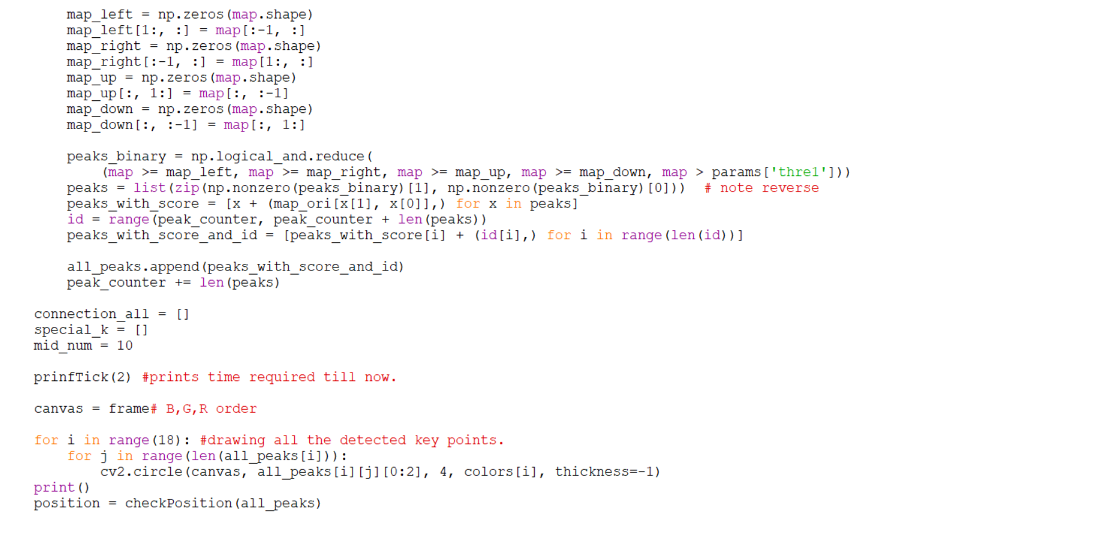
Base Module Functionalities – 1.2

Slide 11
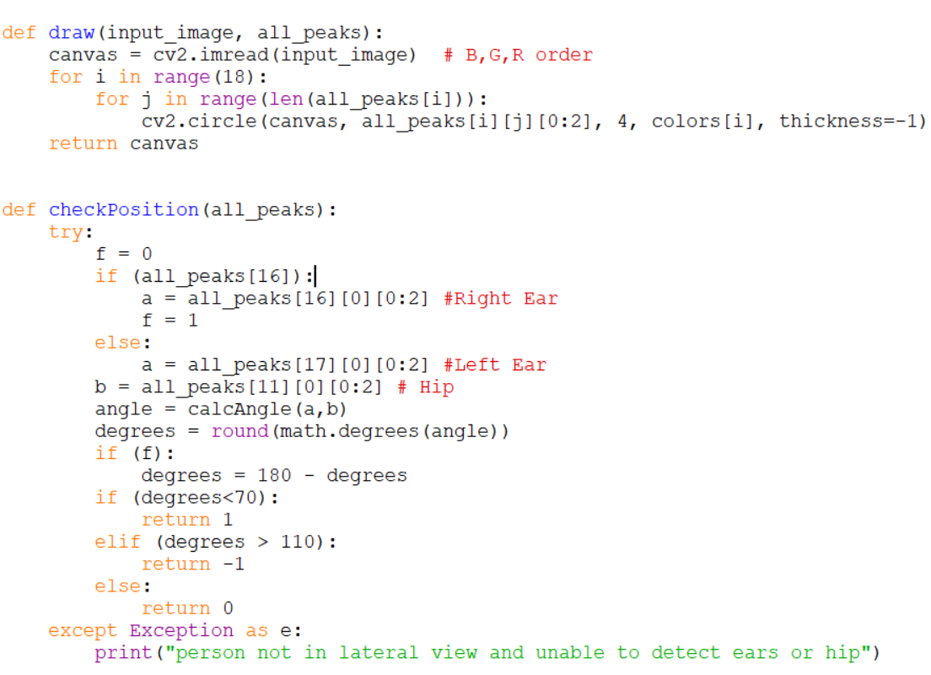
Base Module Functionalities – 2

Slide 12
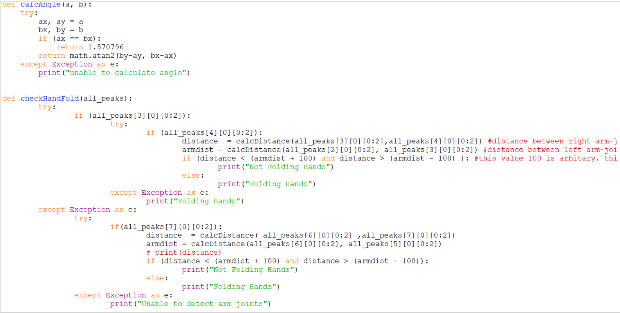
Base Module Functionalities - 3

Slide 13
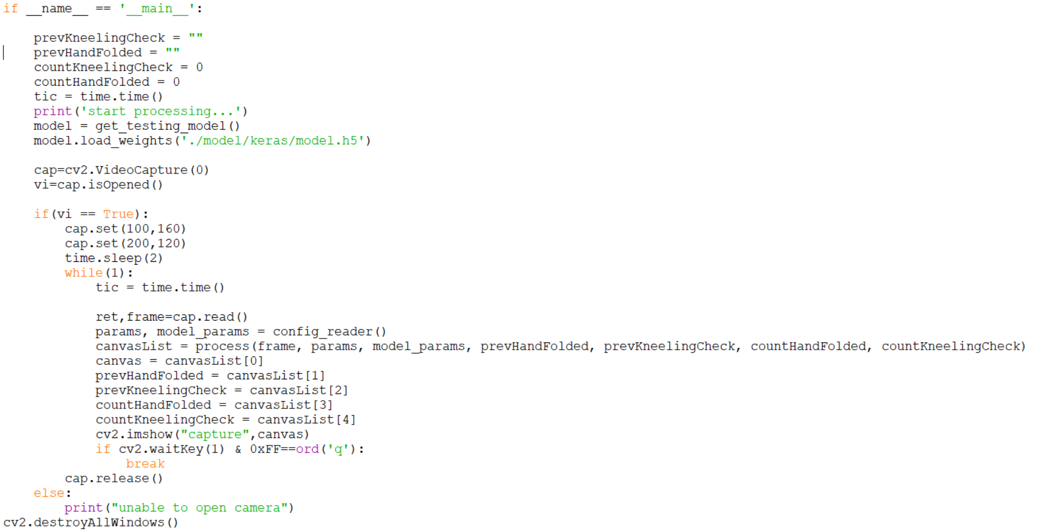
Extending it to Realtime

Slide 14
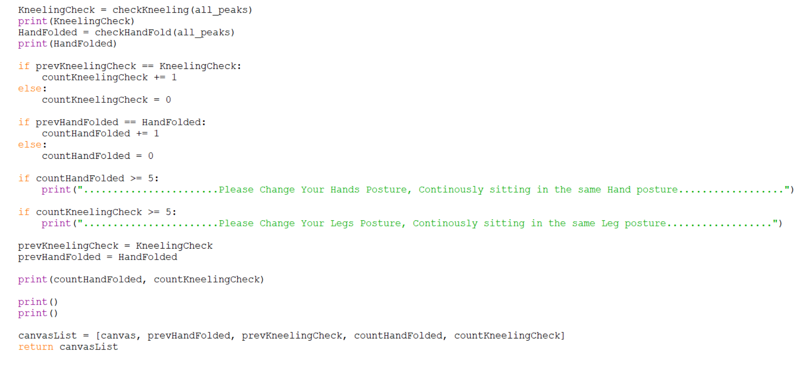
Analyzing & Notifying wrong Posture

Slide 15
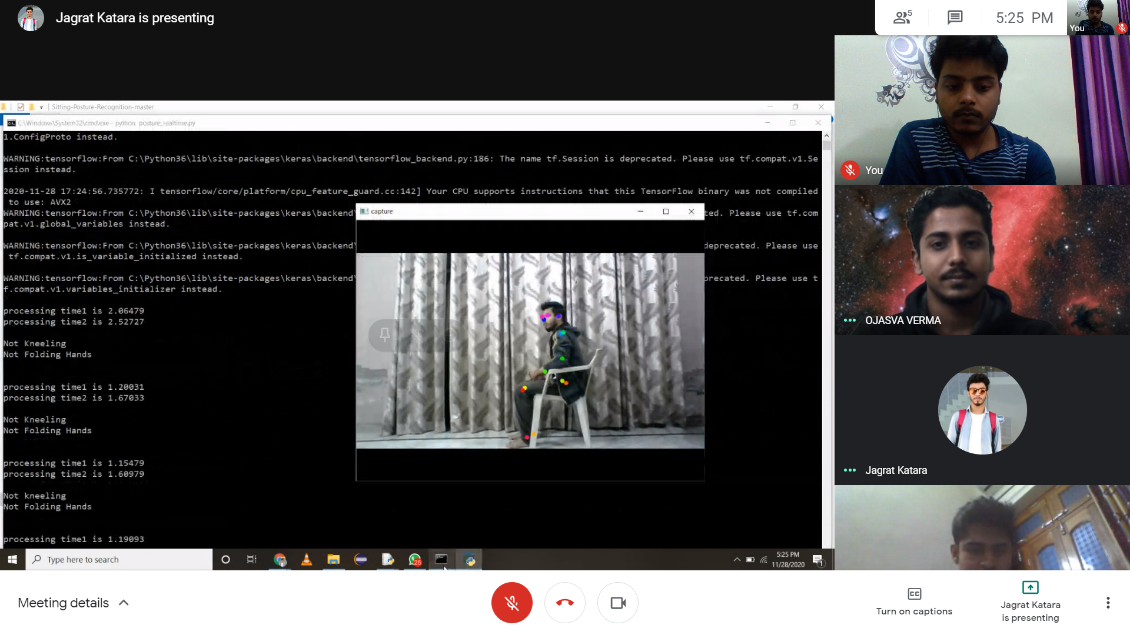
Running Snapshot

Slide 16
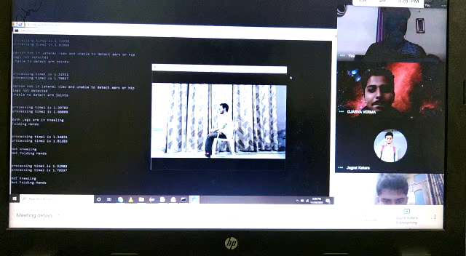
Running Video

Slide 17

Areas of Research
Optimizing the time intervals of capturing snapshots so that alongwith a realtime feel, the application also works efficiently.
•
Extending the module to work for multiple people in the same frame.

Slide 18
Thank You

